Slide 1
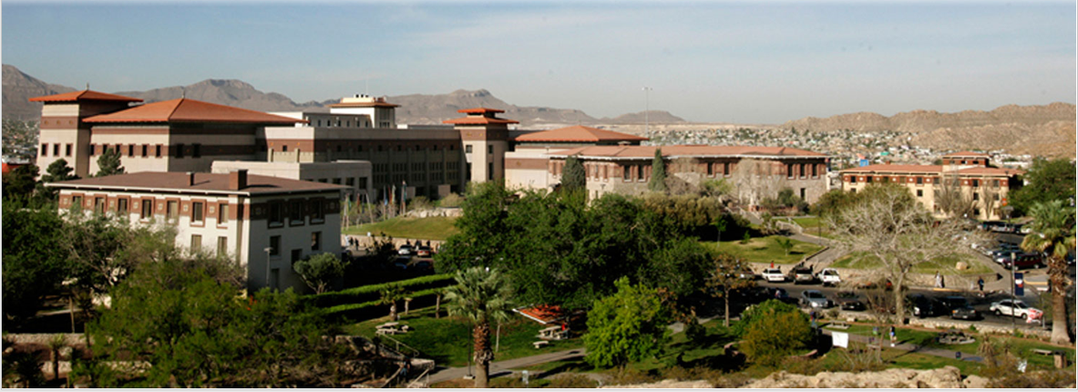

Dakota Integrated with MFiX for UQ Analysis: Sensitivity of particle size on pressure drop in a fluidized bed DEM simulations
VMK Kotteda^{1*^}, V Kumar^{2*}, W Spotz^{3^},A Stephens^{3^},B Adams^{3^}
¹Postdoctoral Researcher, ²Associate Professor, ³Senior Research Staff
*University of Texas at El Paso, Sandia National Laboratories
2018 Multiphase Flow Science Workshop, August 7 – 9, 2018, Houston, USA

Slide 2
Outline
Introduction
Uncertainty quantification (UQ)
Key statistics ideas
Dakota
UQ methods
UQ results (response function- bed height)
Implementation of MFiX in Dakota
UQ results with Dakota-MFiX for fluidized bed ( 2 inputs,1 response fun)
UQ results with Dakota-MFiX for fluidized bed ( 9 uncertain input variables, 2 response functions)

Slide 3
Uncertainty Quantification
UQ is the process of
characterizing input uncertainties,
forward propagating these uncertainties through a computational model, and
performing statistical assessments on the resulting responses.
UQ process determines the effect of uncertainties on model outputs
Why UQ?
Determine low order statistics
Find probability of reaching failure/success criteria
Assess range of possible outcomes
Ultimately, use simulations for risk-informed decision making,
e.g., assess how close uncertainty-endowed code predictions are to Experimental data
Notes:
uncertainty quantification (UQ) or nondeterministic analysis is the process of (1) characterizing input
uncertainties, (2) forward propagating these uncertainties through a computational model, and (3) performing
statistical or interval assessments on the resulting responses. This process determines the effect of uncertainties
and assumptions on model outputs or results. In Dakota, uncertainty quantification methods primarily focus on
the forward propagation and analysis parts of the process (2 and 3),

Slide 4
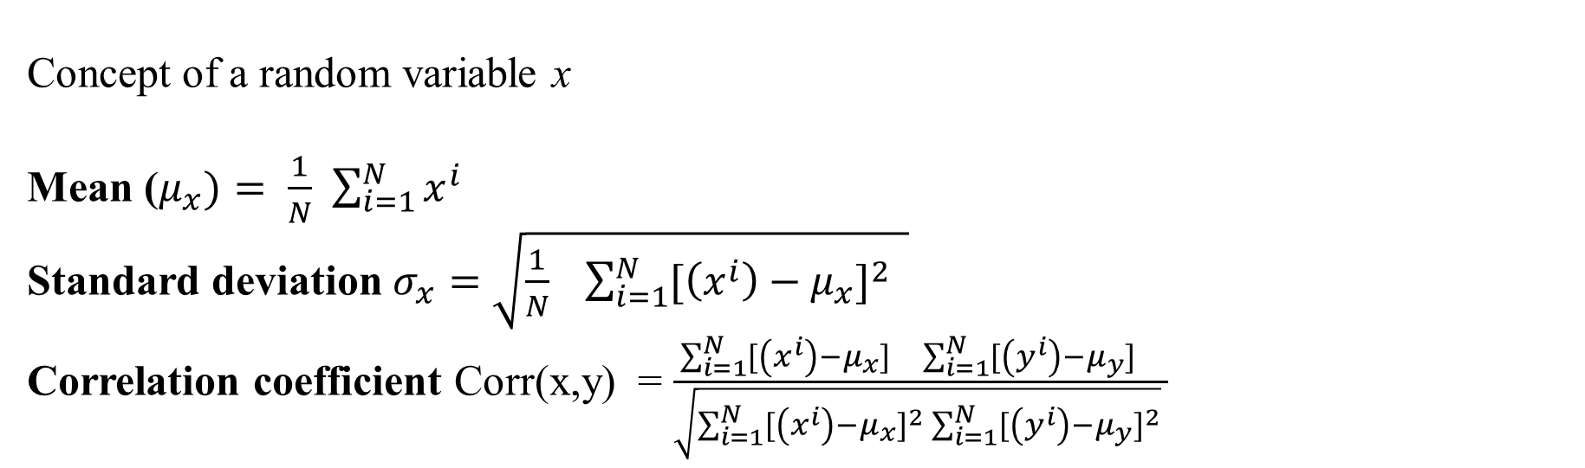
Key Statistics Ideas
Concept of a random variable x
Mean ($μ_{x})= \frac{1}{N}$ $\sum_{i=1}^{N}{x^{i}}$
Standard deviation $σ_{x}=$ $\sqrt{\frac{1}{N} \sum_{i=1}^{N}{{[\left(x^{i}\right)−μ_{x}]}^{2}} }$
Correlation coefficient Corr(x,y) = $\frac{\sum_{i=1}^{N}{{[\left(x^{i}\right)−μ_{x}]}^{}}\sum_{i=1}^{N}{{[\left(y^{i}\right)−μ_{y}]}^{}}}{\sqrt{\sum_{i=1}^{N}{{[\left(x^{i}\right)−μ_{x}]}^{2}}\sum_{i=1}^{N}{{[\left(y^{i}\right)−μ_{y}]}^{2}}} }$
realizations of random variables with
μ=100, σ=10
σ=50
y
y
y
Positive correlation
No correlation
Negative correlation
x
x
x

Slide 5

Dakota has grown significantly beyond an optimization toolkit.
state-of-the-art optimization methods,
methods for sensitivity analysis, parameter estimation, uncertainty quantification, and verification
The toolkit provides a flexible and extensible interface between simulation codes and iterative analysis methods.
Uncertainty in input variables u
Uncertainty in output f(u)
variability,
probabilities,
intervals (ranges)
UQ method
Probability densities
Intervals

Slide 6
UQ methods
Sampling (Monte Carlo, LHS)
Robust, understandable, and applicable to any model
Slow to converge
Moments, PDF/CDF, correlations, min/max
Reliability
Goal-oriented; target particular response or probability levels
Efficient local (require derivatives) / global variants
Moments, PDF/CDF, importance factors
Stochastic Expansions
Surrogate models tailored to UQ for continuous variables
Highly efficient for smooth model responses
Moments, PDF/CDF, Sobol indices
Epistemic
Non-probabilistic methods
Generally applicable, can be costly when no surrogate
Belief/plausibility, intervals, probability of frequency
Consider variable characterizations, model properties, ultimate UQ goal to choose a method
Notes:
Dakota can calculate the derivatives for you to use the reliability methods.

Slide 7
A Practical Process for UQ
environment
method
sampling
sample_type lhs
samples = 1000
seed = 98765 rng rnum2
variables
normal_uncertain = 2
means = 0.80 0.80
std_deviaions = 0.10 0.10
descriptors 'x1' 'x2’
interface
fork
analysis_driver = 'mfix'
responses
response_functions = 1
no_gradients
no_hessians
Identify uncertain input parameters
Characterize input uncertainties and map them into Dakota variable specifications
Select a method appropriate to variables, goal, and problem
Set up Dakota input file and interface to simulation
Run study
Interpret the results

Slide 8
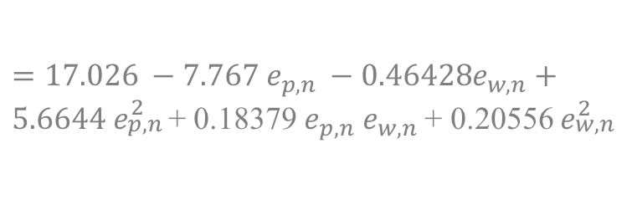
MCS with 100,000 samples
UQ results with Dakota
Case # | Input1 e _{p,n} | Input 2 e _{w,n} | Bed height Sample mean | Bed height Sample Std deviation
1 | N(0.8,0.1) | N(0.8,0.1) | 14.374 | 1.7e-01
2 | N(0.8,0.1) | N(0.8,0.05) | 14.372 | 1.6e-1
Flow in the fluidized bed
e _{p,n} = particle-particle restitution co-efficient
e _{w,n} = Particle-wall restitution co-efficient
UQ results with PSUADE
Response function (Bed height) =
MCS with 100,000 samples
$$=17.026 −7.767 e_{p,n} −0.46428e_{w,n}+$$ $5.6644 e_{\begin{aligned}p,n \\ \end{aligned}}^{2}$+ 0.18379 $e_{p,n}$ $e_{w,n}$ + 0.20556 $e_{\begin{aligned}w,n \\ \end{aligned}}^{2}$
Case # | Input1 e _{p,n} | Input 2 e _{w,n} | Bed height Sample mean | Bed height Sample Std deviation
1 | N(0.8,0.1) | N(0.8,0.1) | 14.371 | 1.7e-1
2 | N(0.8,0.1) | N(0.8,0.05) | 14.367 | 1.5e-1
Surrogate model
Gel, A., Garg, R., Tong, C., Shahnam, M. and Guenther, C., 2013. Applying uncertainty quantification to multiphase flow computational fluid dynamics. Powder technology, 242, pp.27-39.
Notes:
We validated the results with Dakota.
The mismatch in case #2, could be due to rounding off the numbers in the formula.

Slide 9
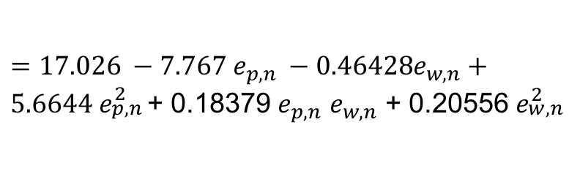
MCS with 100,000 samples
UQ results with Dakota
Case # | Input1 e _{p,n} | Input 2 e _{w,n} | Bed height Sample mean | Bed height Sample Std deviation
1 | N(0.8,0.1) | N(0.8,0.1) | 14.374 | 1.7e-01
2 | N(0.8,0.1) | N(0.8,0.05) | 14.372 | 1.6e-1
e _{p,n} = particle-particle restitution co-efficient
e _{w,n} = Particle-wall restitution co-efficient
Response function - bed height(h) =
$$=17.026 −7.767 e_{p,n} −0.46428e_{w,n}+$$ $5.6644 e_{\begin{aligned}p,n \\ \end{aligned}}^{2}$+ 0.18379 $e_{p,n}$ $e_{w,n}$ + 0.20556 $e_{\begin{aligned}w,n \\ \end{aligned}}^{2}$
PCE (order =5) with different standard deviation specifications for input parameter distributions.
Case # | Input1 e _{p,n} | Input 2 e _{w,n} | Bed height Sample mean | Bed height Sample Std deviation
1 | N(0.8,0.1) | N(0.8,0.1) | 14.374 | 1.7e-01
2 | N(0.8,0.1) | N(0.8,0.05) | 14.372 | 1.6e-1
Notes:
Compared the results with MC (sample size = 100000) and PCE (order =5) methods.

Slide 10
MCS– sample size study
UQ results with Dakota
samples # | Input1 e _{p,n} | Input 2 e _{w,n} | h mean | h Std deviation
100,000 | N(0.8,0.1) | N(0.8,0.1) | 14.374 | 1.65e-01
10,000 | N(0.8,0.1) | N(0.8,0.1) | 14.374 | 1.65e-01
1000 | N(0.8,0.1) | N(0.8,0.1) | 14.374 | 1.65e-01
500 | N(0.8,0.1) | N(0.8,0.1) | 14.374 | 1.65e-01
200 | N(0.8,0.1) | N(0.8,0.1) | 14.374 | 1.66e-01
100 | N(0.8,0.1) | N(0.8,0.1) | 14.376 | 1.73e-01
50 | N(0.8,0.1) | N(0.8,0.1) | 14.372 | 1.59e-01
20 | N(0.8,0.1) | N(0.8,0.1) | 14.363 | 1.40e-01
10 | N(0.8,0.1) | N(0.8,0.1) | 14.356 | 1.32e-01
Notes:
The effect of sample size on UQ statistics.

Slide 11
Implementation of MFiX in Dakota
Identify uncertain input parameters
Characterize input uncertainties and map them into Dakota variable specifications
C++ Wrapper
Select a method appropriate to variables, goal, and problem
Create separate work directories for each independent run
Make the input file for MFiX simulations
Run MFiX simulations
Calculate the response functions
Set up Dakota input file and interface to simulation
Run study
Interpret the results

Slide 12
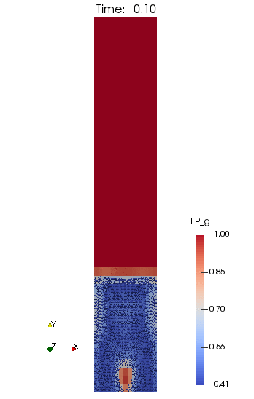
Flow in the fluidized bed
Central jet fluidized bed using DEM simulations.
Central jet velocity = 4200 cm/s
Size of the Domain - 15cm x 90 cm
cells having width of 1 cm and height of 2 cm, resulting in a total of 675 (=15x45) computational cells.
The bed is initialized with 217.15 g of particles with a diameter of 0.4 cm and density of 2.7 g/cm3, resulting in total of 2400 spherical particles.
parameter | value
Particle-particle restitution co-efficient | 0.80
Particle-wall restitution co-efficient | 0.80
Average bed height = 14.38 cm
Notes:
Show the instantaneous value.

Slide 13

Dakota-MFiX results: Flow in a fluidized bed
Input 1 - e _{p,n} | Input 2 - e _{w,n}
N(0.8,0.07) | N(0.8,0.07)
e _{p,n} = particle-particle restitution co-efficient
e _{w,n} = particle-wall restitution co-efficient
Response function
Bed height =
$$\sum_{n=1}^{N_{p}}{Y^{n} /N_{p}}$$
N _{p} = Number of particles (=2400)
Y = y- coordinate of n^{th} particle's position at time t
PCE, Order =5
sample size =25
LHS, sample size =500
Mean
Std
14.41
3.62e-02
14.41
3.41e-02
Partial Correlation Matrix between input and output:
Bed height
e_{p,n} 5.00894e-01
e_{w,n} -2.28789e-01
Notes:
Response function Std is 0.23% of mean
Input variables std is 5% of mean
Bed height for e _{p,n} = 0.8 and e _{w,n} = 0.8 is 14.38
Bed height from UQ is 14.41 – 0.03 = 14.38 14.32 – 0.06 = 14.26

Slide 14

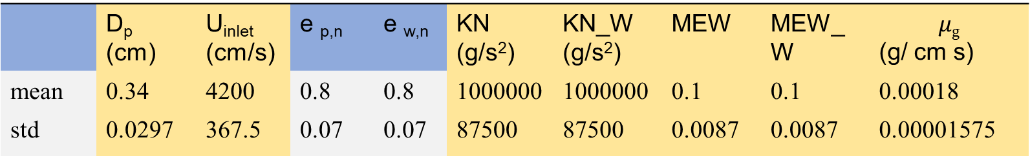
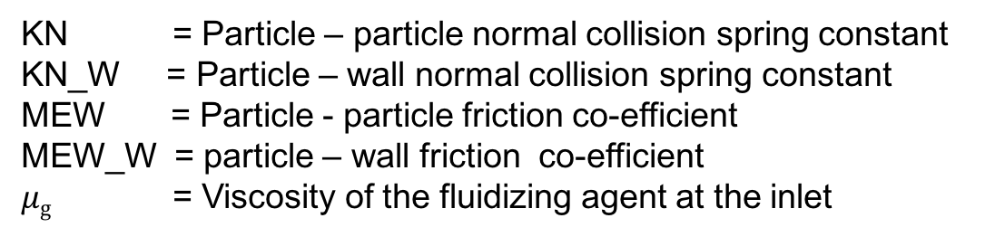
Dakota-MFiX results: Flow in a fluidized bed
Normal distribution, LHS, # of uncertain input variables = 9
 | D_{p} (cm) | U_{inlet} (cm/s) | e _{p,n} | e _{w,n} | KN (g/s²) | KN_W (g/s²) | MEW | MEW_W | $$μg$$ (g/ cm s)
mean | 0.34 | 4200 | 0.8 | 0.8 | 1000000 | 1000000 | 0.1 | 0.1 | 0.00018
std | 0.0297 | 367.5 | 0.07 | 0.07 | 87500 | 87500 | 0.0087 | 0.0087 | 0.00001575
D_{p} = Particle diameter
U_{inlet} = Velocity of the fluidizing agent at the inlet
e _{p,n} = particle-particle restitution co-efficient
Response function
1. Average bed height
$$H_{p}(t)=\sum_{n=1}^{N_{p}}{Y^{n} /N_{p}}$$
e _{w,n} = particle-wall restitution co-efficient
KN = Particle – particle normal collision spring constant
KN_W = Particle – wall normal collision spring constant
MEW = Particle - particle friction co-efficient
MEW_W = particle – wall friction co-efficient
$μg$ = Viscosity of the fluidizing agent at the inlet
2. Maximum pressure difference across the bed

Slide 15

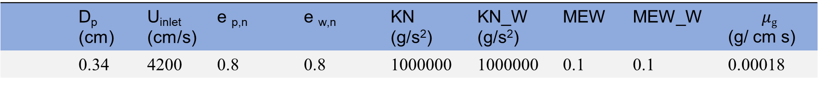
Dakota-MFiX results: Flow in a fluidized bed
# of uncertain input variables = 9
 | D_{p} (cm) | U_{inlet} (cm/s) | e _{p,n} | e _{w,n} | KN (g/s²) | KN_W (g/s²) | MEW | MEW_W | $$μg$$ (g/ cm s)
 | 0.34 | 4200 | 0.8 | 0.8 | 1000000 | 1000000 | 0.1 | 0.1 | 0.00018
Response function
1. Average bed height
$$H_{p}(t)=\sum_{n=1}^{N_{p}}{Y^{n} /N_{p}}$$
2. Maximum pressure difference across the bed
Bed height at t=40 is 9.87 cm
Max pressure drop at t=40 is 15.99 k dn/cm²

Slide 16
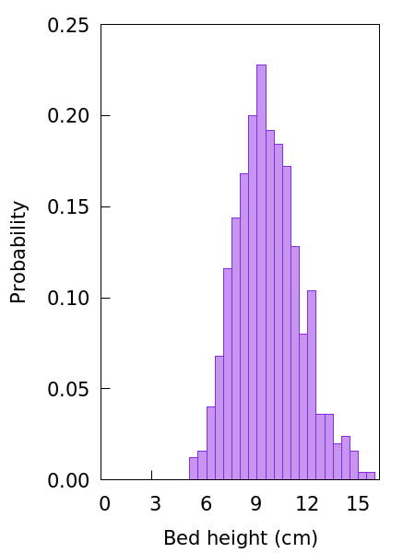
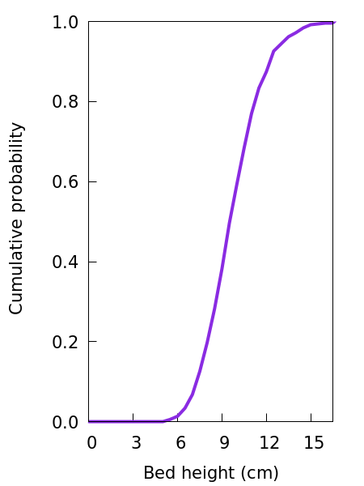
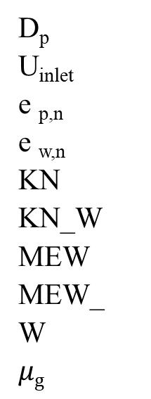
Response function – bed height
Normal distribution
, LHS, sample size = 500
Mean:
Std:
9.6827
1.9529
Partial Correlation Matrix between
input and output:
Bed height
9.87853e-01
7.65915e-01
1.26841e-03
-2.19558e-02
-5.44667e-02
-4.08984e-02
-1.03671e-02
6.74702e-02
-1.76986e-02
D_{p}
U_{inlet}
e _{p,n}
e _{w,n}
KN
KN_W
MEW
MEW_W
$$μg$$

Slide 17
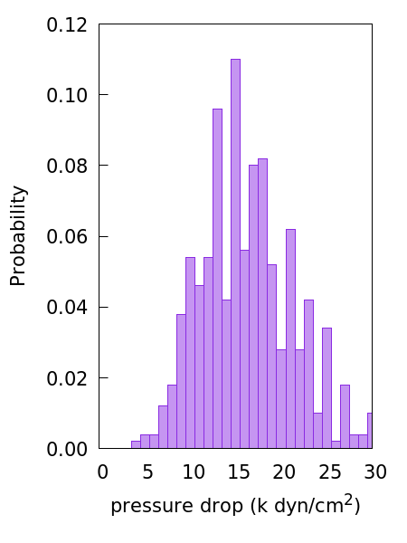
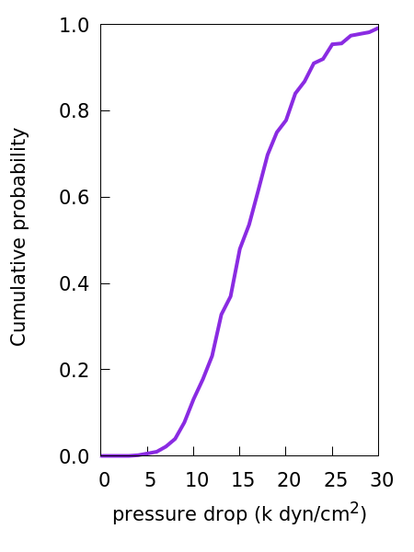
Response function – Max pressure drop across the bed
Normal distribution
, LHS, sample size = 500
Mean:
Std:
1.5857e+04
5.2590e+03
Partial Correlation Matrix between
input and output:
Pressure drop
9.81640e-01
-4.91593e-01
5.73839e-02
1.11189e-01
-7.00940e-02
-1.14437e-02
3.87739e-02
3.50937e-02
-2.23406e-02
D_{p}
U_{inlet}
e _{p,n}
e _{w,n}
KN
KN_W
MEW
MEW_W
$$μg$$

Slide 18
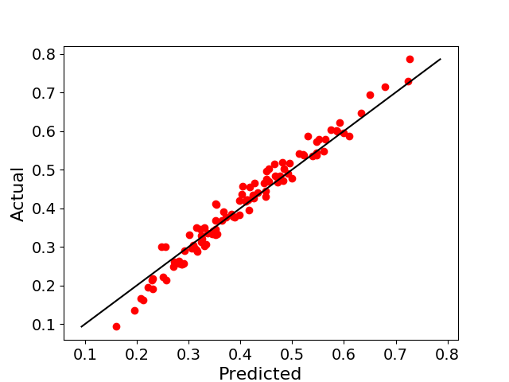
Dakota-ML results: Flow in a fluidized bed
Normal distribution, LHS, sample size = 100,000
Response function - Max pressure difference across the bed
Mean:
Std:
1.53791e+04
2.99497e+03
1.5294216466e+04
2.7316445141e+03
global regression
orthogonal polynomial
Approximation
Deep Neural Network
(training sample size=400,
N(0.8,0.07), …..
Testing sample size = 100
N(0.8,0.07), ….
DNN
Variance = 0.96
1.5854484429e+04
+ 5.1191312475e+03 D_{p}
-5.6223801405e+02 U_{inlet}
+ 1.0102024535e+02 e _{p,n}
+ 1.1853996506e+02 e _{w,n}
+ 5.2048560208e+02 D_{p}*D_{p}
+ 1.8268743945e+02 D_{p}* U_{inlet}
+ 1.8787829466e+02 U_{inlet} * U_{inlet}
Notes:
Response function Std is 0.23% of mean 0.17% of mean
Input variables std is 5% of mean
Bed height for e _{p,n} = 0.8 and e _{w,n} = 0.8 is 14.38
Bed height from UQ is 14.41 – 0.03 = 14.38 14.41 – 0.03 = 14.38

Slide 19






Acknowledgement
Thank you

Slide 21
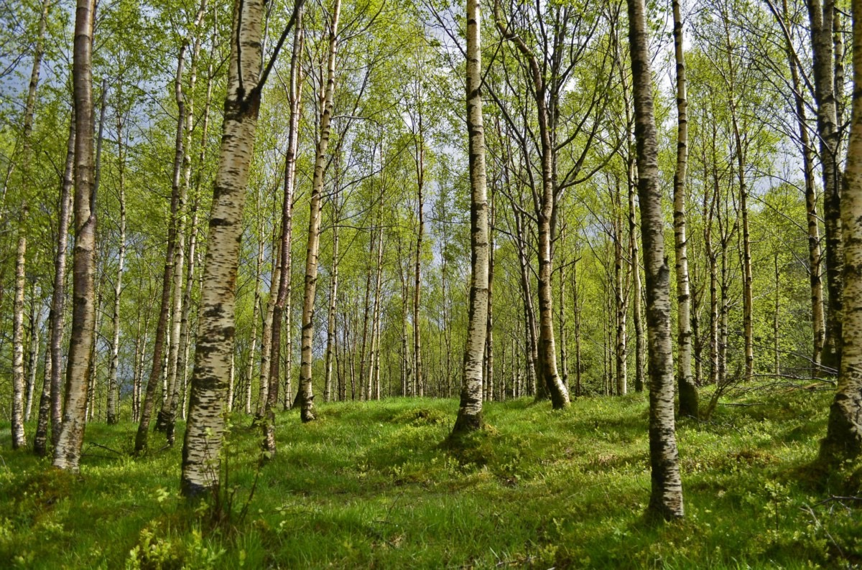
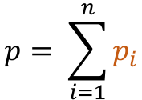
Random Forest Algorithm
Random Forest is a supervised learning algorithm.
It is a flexible, easy to use machine learning algorithm that produces, even without hyper-parameter tuning, a great result most of the time.
It is also one of the most used algorithms, because it’s simplicity and the fact that it can be used for both classification and regression tasks.
It is derived from decision trees. Instead of applying decision tree algorithm on all dataset, dataset is separated into subsets and same decision tree algorithm is applied to these subsets.
Decision is made by the highest number of subset results.
Tree 1
Tree 2
Tree n
P₁
P₂
P_{n}
$$p= \sum_{i=1}^{n}{p_{i}}$$
ensemble of decision Trees
creates a forest and makes it somehow random.

Slide 22
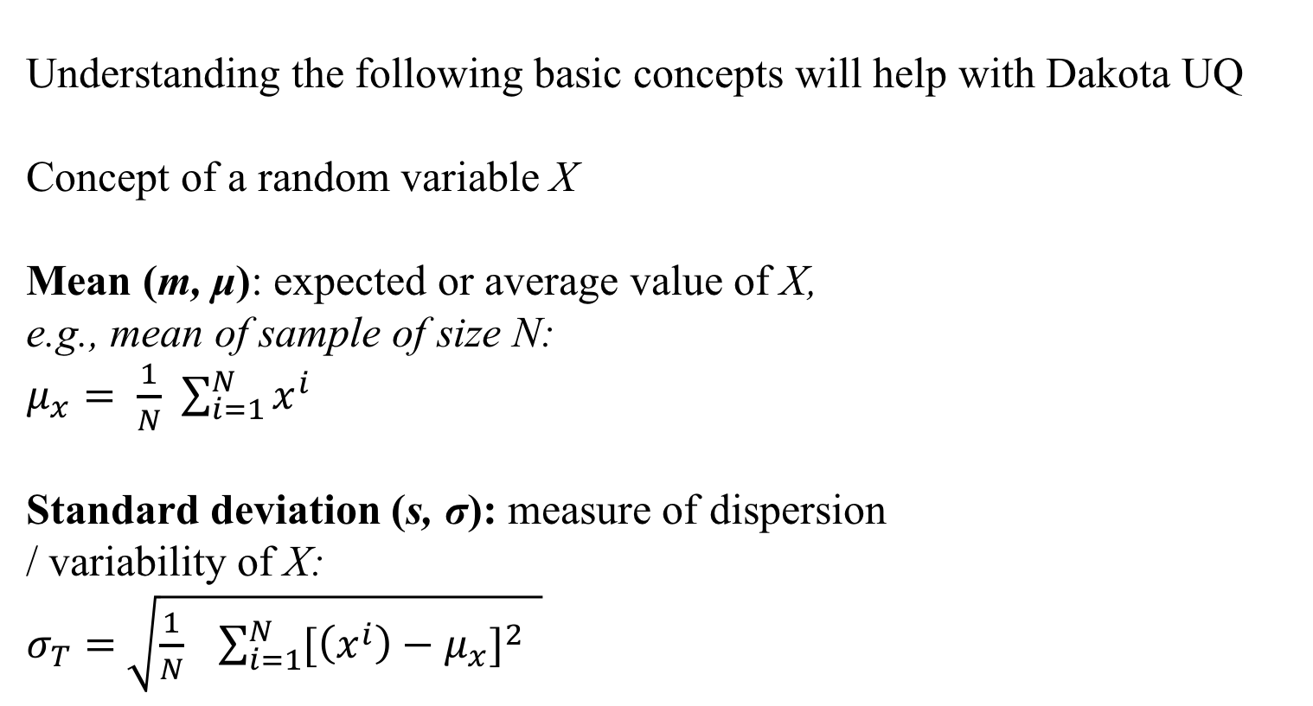

Deep Neural Network
It is one of the widely used machine learning algorithms
Artificial Neural Networks (ANN) are biologically inspired networks for performing certain specific tasks such as regression.
ANN is similar to neural networks in two ways: acquire knowledge through training and apply the knowledge within inter-neuron connection strengths known as weights.
ANN and more complex deep learning techniques are some of the tools for solving very complex problems.
Neuron
w1
w7
0,0,1,1
w2
w3
w8
w4
w5
0,1,0,1
w6
w9
To get the result from the sum, we apply the activation
function, sigmoid, to each element:
Input layer
Output
Hidden layer
Sigmoid hidden layer sum = hidden layer result
This can be represented as
4x3
4x3
$$\begin{matrix}0 & 0 \\ 0 & 1 \\ \begin{aligned}1 \\ 1\end{aligned} & \begin{aligned}0 \\ 1\end{aligned}\end{matrix}$$
hidden layer sum
Sigmoid
hidden layer result x w7 w8 w9
= [output]
X
$$\begin{matrix}\begin{aligned}w1 \\ w4\end{aligned} & \begin{aligned}w2 \\ w5\end{aligned} & \begin{aligned}w3 \\ w6\end{aligned}\end{matrix}$$
=
4x3
3x1
Notes:
The forward propagation process is a series of sum products and transformations. Let’s calculate the first hidden sum with all four input data:
We do this for every node in the hidden layer, and this becomes our input for the next layer, our output layer. After applying the activation function on the output node value, this is what we interpret as the output of the neural network. It will probably be off from what it should be because the initial weights are random and that will give us a random answer. But that leads us to the next process, which will help us find the right weights

